Slide 1
Centralized wPRF (packed)
Files:
PRF.cpp
PackedMod2.hpp
PackedMod2.hpp
methods | No.of times | Cost for each call | Total call
toeplitzByVec | 1 | 25n | 25n
toArray | 1 | 2n | 2n
fromArray | 1 | 8n | 8n
matByVec | 1 | 37n | 37n
Total | 3 |  | ~72n = 18,432

Slide 2
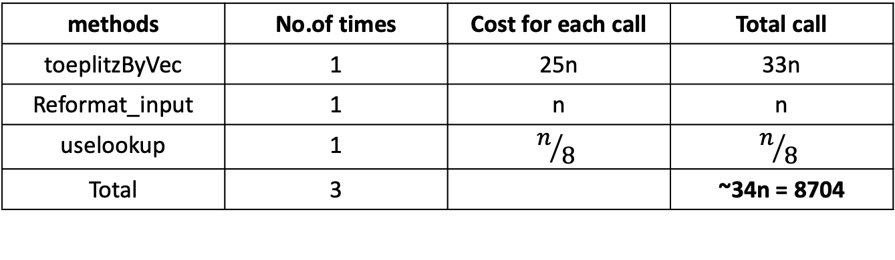
Centralized wPRF (packed + lookup table)
Files:
test_packed_PRF_central_lookup.cpp
lookup_functions.cpp
PackedMod2.hpp
methods | No.of times | Cost for each call | Total call
toeplitzByVec | 1 | 25n | 33n
Reformat_input | 1 | n | n
uselookup | 1 | $$n/8$$ | $$n/8$$
Total | 3 |  | ~34n = 8704

Slide 3
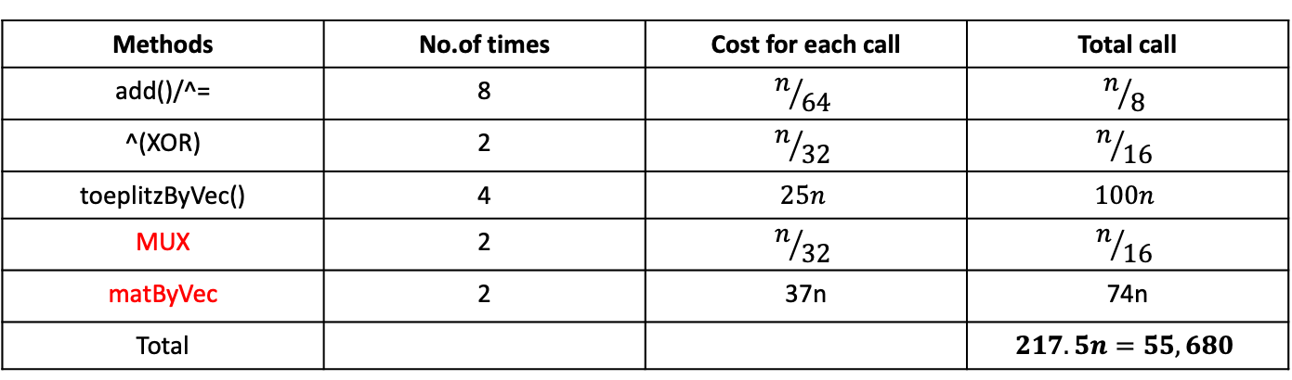
DIDO(Fully Distributed with packed)
Files:
new_protocol.cpp
lookup_functions.cpp
PackedMod2.hpp
PackedMod3.hpp
Methods | No.of times | Cost for each call | Total call
add()/^= | 8 | $$n/{64}$$ | $$n/8$$
^(XOR) | 2 | $$n/{32}$$ | $$n/{16}$$
toeplitzByVec() | 4 | $$25n$$ | $$100n$$
MUX | 2 | $$n/{32}$$ | $$n/{16}$$
matByVec | 2 | 37n | 74n
Total |  |  | $$217.5n=55,680$$

Slide 4
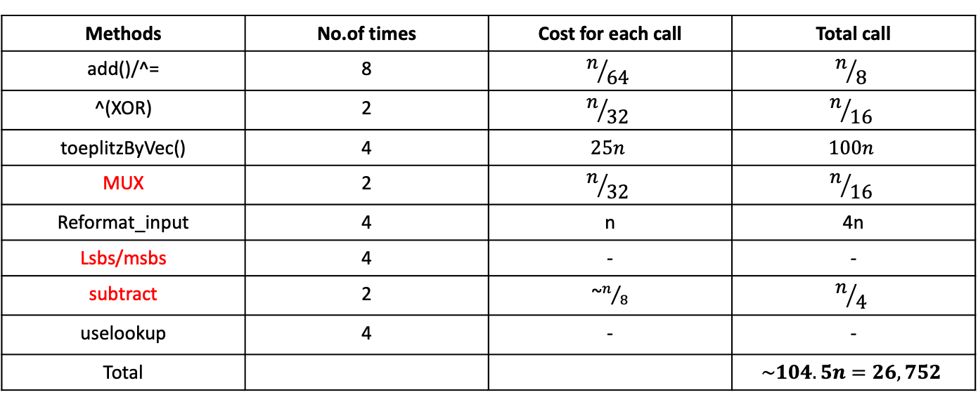
DIDO(Fully Distributed with packed and lookup)
Files:
new_protocol.cpp
lookup_functions.cpp
PackedMod2.hpp
PackedMod3.hpp
Methods | No.of times | Cost for each call | Total call
add()/^= | 8 | $$n/{64}$$ | $$n/8$$
^(XOR) | 2 | $$n/{32}$$ | $$n/{16}$$
toeplitzByVec() | 4 | $$25n$$ | $$100n$$
MUX | 2 | $$n/{32}$$ | $$n/{16}$$
Reformat_input | 4 | n | 4n
Lsbs/msbs | 4 | - | -
subtract | 2 | ~$n/8$ | $$n/4$$
uselookup | 4 | - | -
Total |  |  | $$\sim 104.5n=26,752$$

Slide 5

DIDO(Fully Distributed with packed)
party1_round_1: 9 operations
Party2_round_1: same
Both K, $Rk_{1}$ are Toeplitz

